Slide 1


Is it time for supporters to own Dulwich Hamlet FC?
James Mathie
SD Club Development

Slide 2

A bit about us
We were set-up in 1999 to help to bring supporters of English football clubs closer to their supporters and their community by setting up Supporters Trusts inspired by the work of Brian Lomax at Northampton Town
In the UK we have now set up 190 Supporters Trusts with a combined membership of over 750,000 members
These groups have collectively raised more than £40 million which has been reinvested to help them increase their involvement with club and community
We now provide help to supporters across 23 European countries
We train, skill and support hundreds of volunteers
We utilise our unique experience of spectator sport to produce research & best practice, which is not only academically robust but based on experience
This work led us to applying the same principles to sports clubs….

Slide 3

SD Club Development
Set-up in June 2013
SDCD offers 3 core services
  Creating community owned clubs
  Developing existing community owned clubs
  Exploring community ownership opportunities

Slide 4
We believe success flows from your choice of Club structure…

Slide 5

…get it right & you set yourselves up for
More supporters
More volunteers
More sponsors
More trust
More money
More protection
More sustained success

Slide 6

A few questions to consider…
Does our existing structure encourage people to be part of the club?
Do we want one, a few or lots of people to own the club?
If we want to widen the ownership to as many people as possible, how do we make decisions with so many opinions?
Do we have aspirations to own and develop facilities for the club?
How will they be funded?
Could our club structure help us reduce costs and increase income?
Would changing our legal entity help? If so what are the options?

Slide 7
What do SDCD think a good club looks like?
Open membership to people who support the objects of the club
One member one vote for members
Annual membership renewal
Able to raise money in a cost effective way
Able to raise money without changing the one member one vote dynamic
A governing board which is predominantly elected by the membership
Delegated authority given to staff/volunteers to operate day to day issues
A club that only spends what it earns with any profits reinvested
Assets of the club protected
A legal structure that reflects what we are, and helps our profile

Slide 8








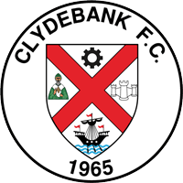

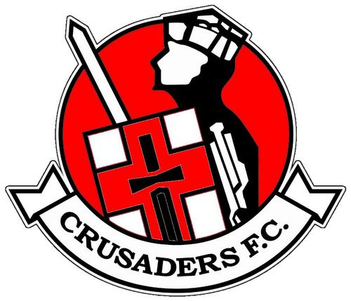



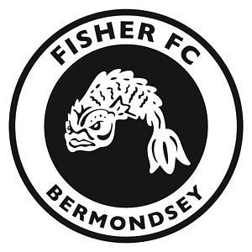

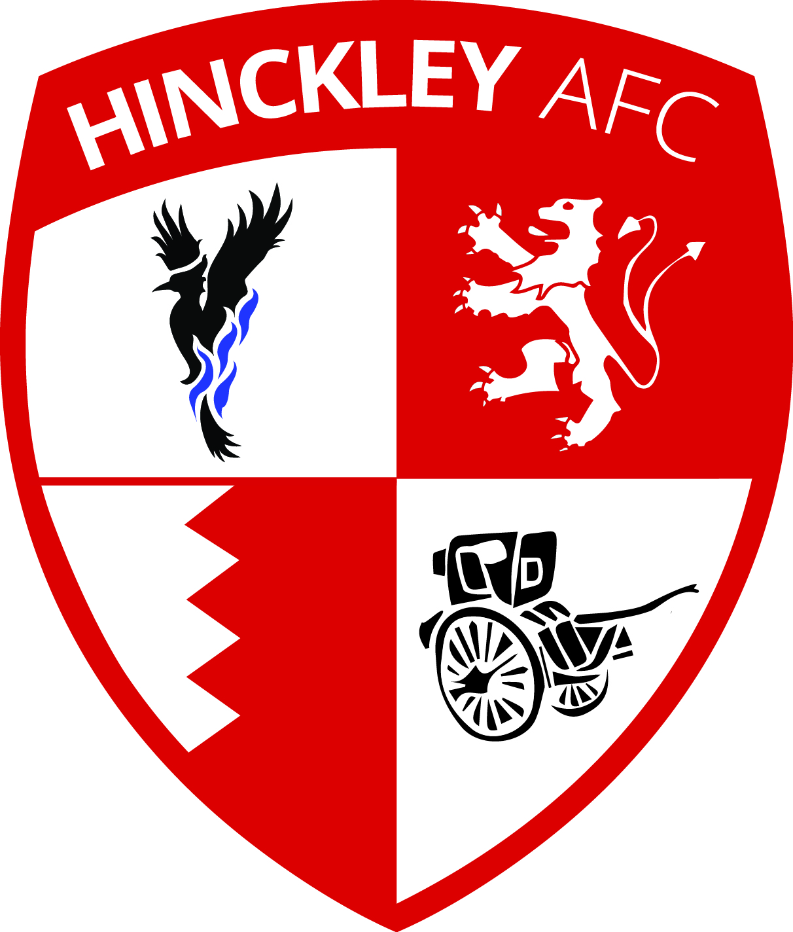


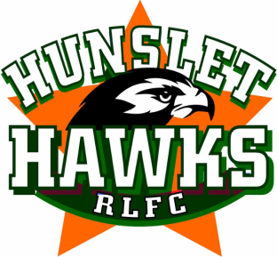
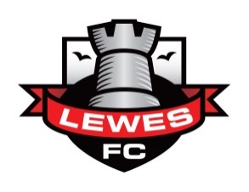
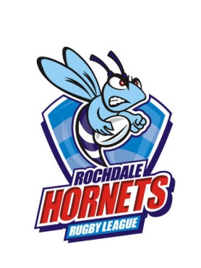

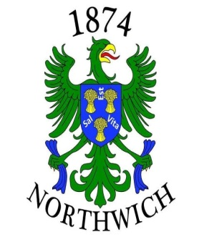

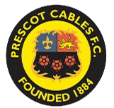





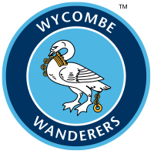

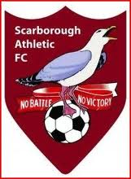




Slide 9
How they became community owned
August 2013 August 2014

Slide 10







Potential legal models in non-league football
Unincorporated
Private Company Limited by Shares
Company Limited by Guarantee
Community Interest Company (by S or G)
Community Benefit Society
What about Charities? or
Community Amateur Sports Clubs?

Slide 11

If we want community ownership at our level of football
Unincorporated
Private Company Limited by Shares
Company Limited by Guarantee
Community Interest Company (by S or G)
Community Benefit Society
What about Charities? or
Community Amateur Sports Clubs?

Slide 12

Comparing the legal models that deliver community ownership
 |  | CLG | CIC (hybrid) | CBS
Open membership
One member one vote
Annual membership renewal
Cost effective way to raise money from shares
Able to raise money from shares with 1m 1v structure
Some board places elected annually by membership
Board able to delegate day to day activity
Spend what we earn, profits reinvested
Assets protected
Legal structure that helps our profile

Slide 13
A few burning questions about supporter ownership?
Where is the money coming from?
Who makes the decisions?
How do we deal with outside investment?
Will we be competitive?
What would it cost to join?
Can volunteers really do this – will I see my friends/family etc ever again?!
Has it failed?
How does this relate to the proposed ground development?
Is 100% ownership important?
Others?

Slide 14
AFC Telford United
Trading profit in 8 out of their 9 years as a community owned club
Play at the same level as the previous club that was wound up in 2004 with over £4 million of debt
Estimate about £300k of volunteer support per year
Formed strong partnership with local stakeholders which led to a new learning centre, artificial pitch and sports Dome
Secured a long term sponsor in Cap Gemini until 2017; great for budgeting
More resilience with attendances holding up when the team has been playing badly and was relegated in 2012/13

Slide 15
How our relationship continues
Membership
free in 1st year
£100 p/a thereafter (optional to rejoin)
Clubs network
Annual clubs conference
Online forum, library, directory to share ideas and networks
Legal helpline
DWF
Research & guidance
Copies of our publications
Commercial partners
Opportunities for clubs in our network
Promotion
Showcasing clubs
Education
Highlighting best practice
Lobbying
Working for changes that benefit member clubs
Policy & research
Undertaking research & co-ordinating policies for the benefit of member clubs (e.g. COSC)
Internal
External

Slide 16
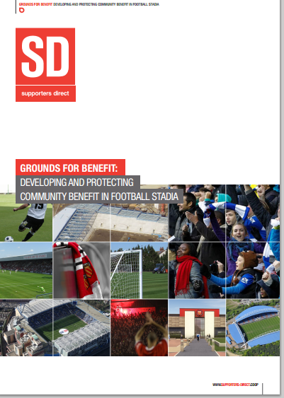
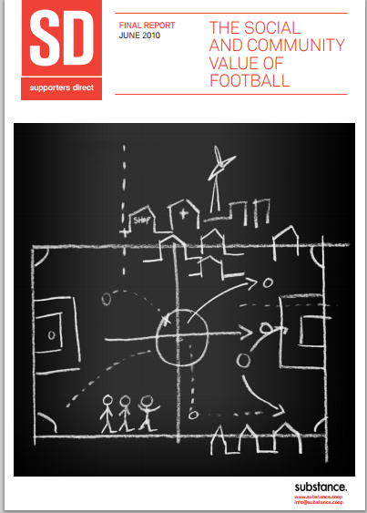
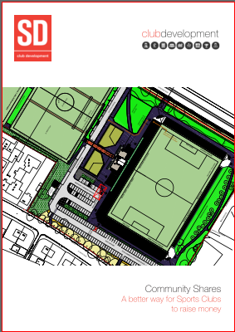
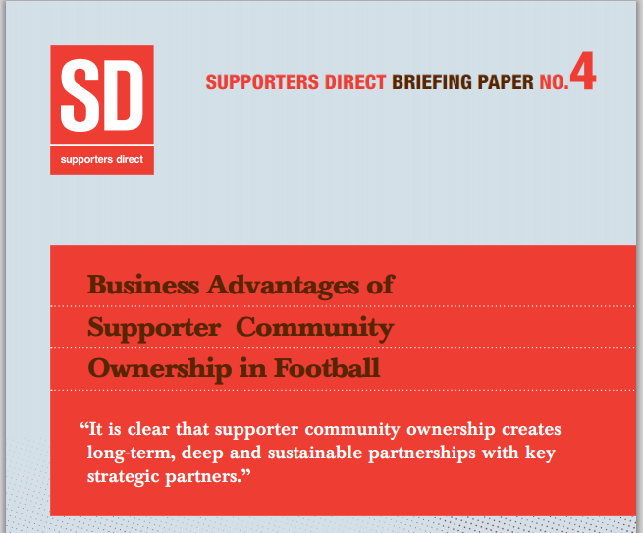
Evidence based – some of our research

Slide 17
Service 1: Creating community owned clubs
Our 3 stage model
Club health check
  An assessment of the Club in key areas
  (governance, finance, compliance, operations)
Community Ownership
  Consultation with the community
  incorporation of the appropriate legal model
  training to the Board on their responsibilities
Club Development
  Supporting the Club identify opportunities they are now better positioned to take advantage of
  (asset transfer, raising finance for facility development etc)

Slide 18
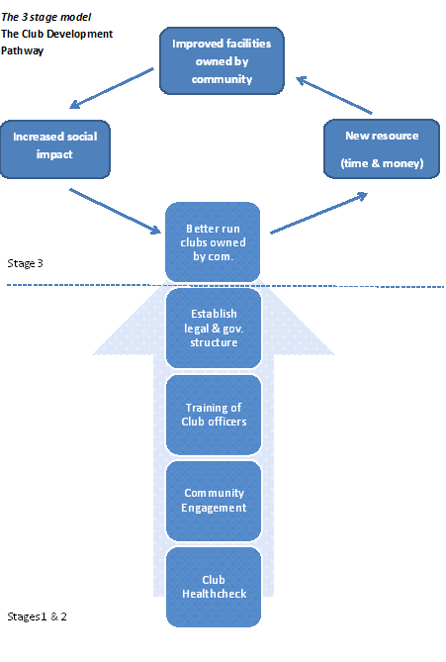

Slide 19
Service 2: Developing community owned clubs
In a number of ways including
Governance and club structure reviews
Feasibility studies for facility developments
Business planning
Asset transfer and protection
Identifying and securing finance, to include…

Slide 20
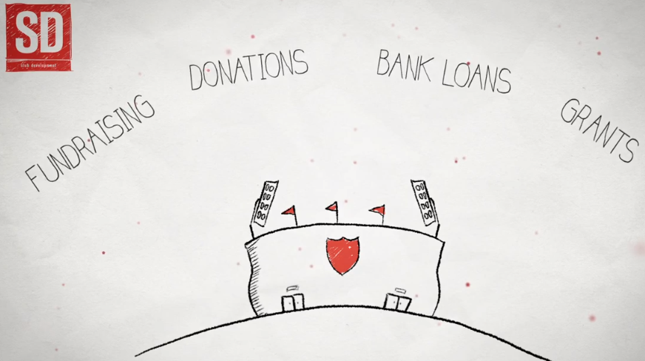
Community shares
a new way to raise finance

Slide 21
Service 3: Exploring community ownership
Normally to include
Supporter/community consultations
Due diligence
Legal support
Raising finance

